Slide 1
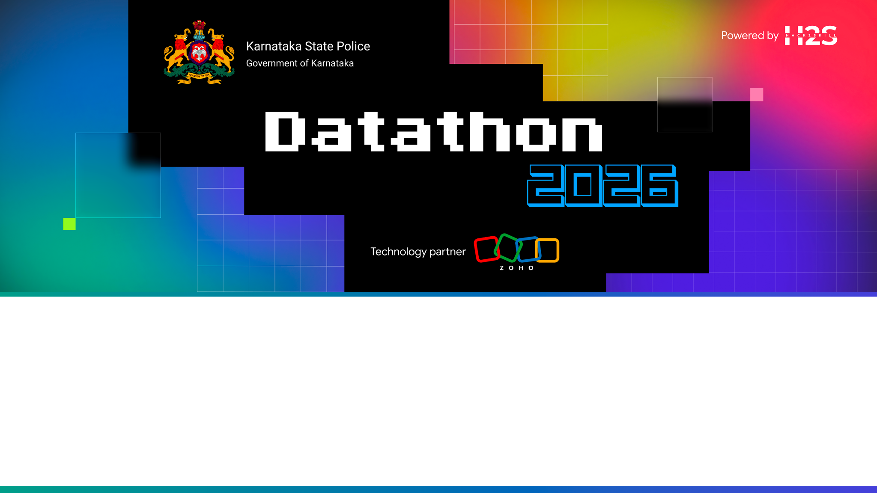
Team Details
Team name: CrimeSense by DevWithData
Team leader name: Shashikant
Team size: 1
Problem Statement: Intelligent Conversational AI for KSP Crime Database

Slide 2

Brief about the solution
CrimeSense is an Intelligent Conversational AI & Crime Analytics platform for the KSP crime database.
Investigators, analysts and policymakers ask questions in plain English or Kannada (text or voice) and get instant answers — backed by a transparent evidence trail showing the exact data and reasoning used.
Beyond simple retrieval, it discovers hidden links between crimes, offenders, victims, locations and money flows — powering crime-pattern discovery, criminal-network analysis, offender risk-scoring and proactive, preventive policing intelligence.
Built for solo-team delivery and deployed on Catalyst by Zoho. Runs on fully synthetic, NCRB/KSP-structured data — no real personal data.

Slide 3
Opportunities
How different is it from any of the other existing ideas?
How will it be able to solve the problem?
USP of the proposed solution
How it is different:
• Not a dashboard or a search box — a conversational, context-aware analyst that explains every answer (SQL + reasoning), in English and Kannada.
How it solves the problem:
• One natural-language interface over FIRs, accused, victims, locations and transactions, plus network analysis, risk-scoring and money-trail tracing for real investigative leads.
USP:
• Explainable-by-design + bilingual + voice + offline NL→SQL (no API key needed) + role-based access & audit logs — purpose-built for law-enforcement accountability.

Slide 4
List of features offered by the solution
1. Conversational Crime Intelligence
NL→SQL chat, EN/Kannada, voice, PDF export
2. Criminal Network Analysis
Co-offending graph, gangs, kingpin detection
3. Crime Pattern & Trend Analytics
Hotspots, yearly trend, seasonality
4. Sociological Insights
Age, gender, education, occupation patterns
5. Offender Profiling & Risk Scoring
Repeat offenders, transparent risk score
6. Investigator Decision Support
Case summaries, status, similar cases
7. Financial Crime & Money-Trail
Multi-hop tracing, suspicious-txn flags
8. Crime Forecasting
Trend/seasonality, QuickML-ready
9. Explainable AI
Evidence trail: data refs + SQL + reasoning
10. Secure Role-Based Access
Roles + audit logs + data protection

Slide 5
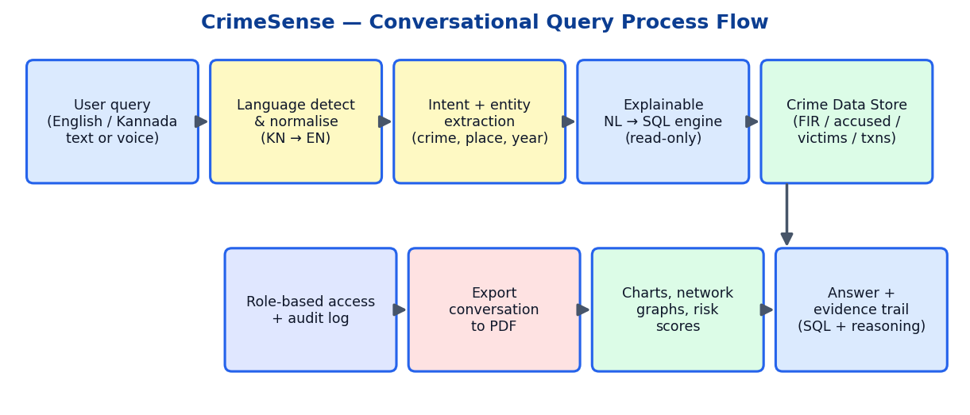
Process flow diagram or Use-case diagram

Slide 6
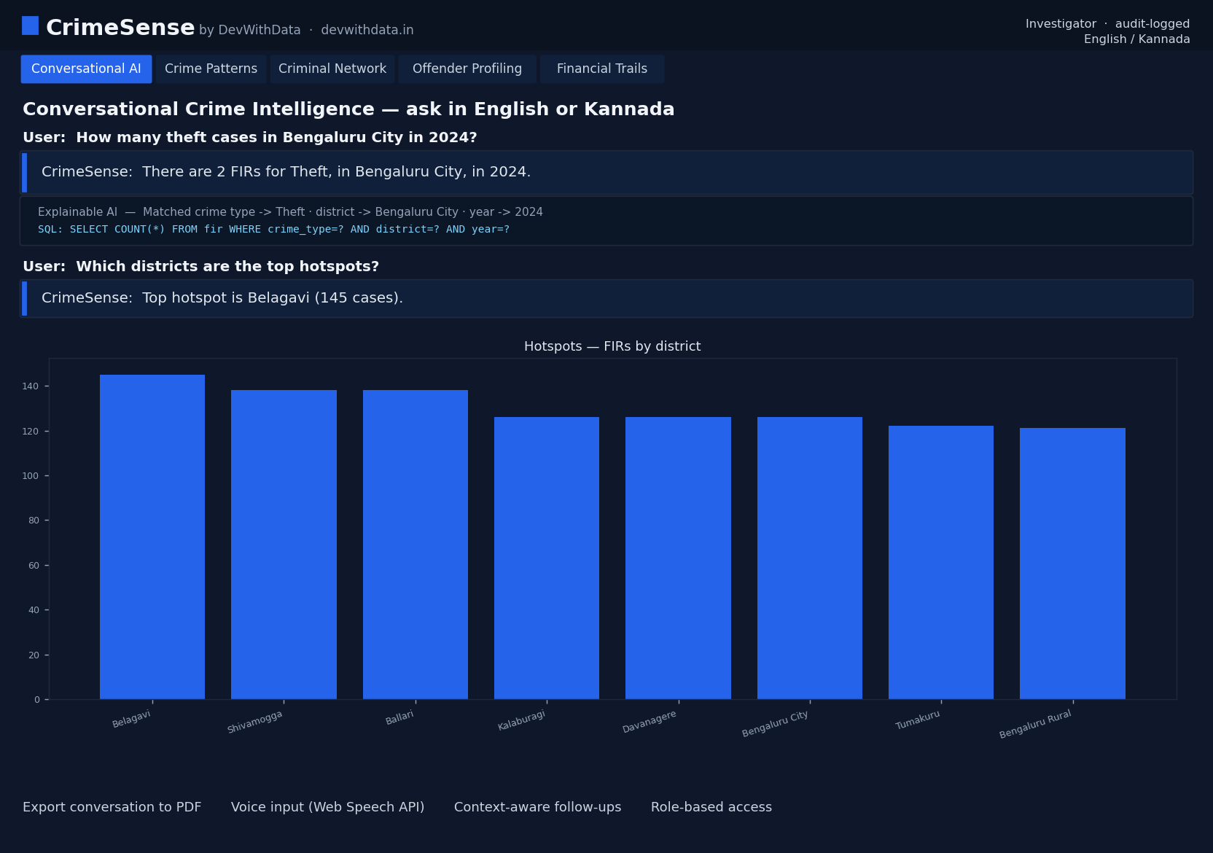
Wireframes/Mock diagrams of the proposed solution (optional)
Conversational AI screen — question, answer, explainable evidence trail and auto-generated chart.

Slide 7
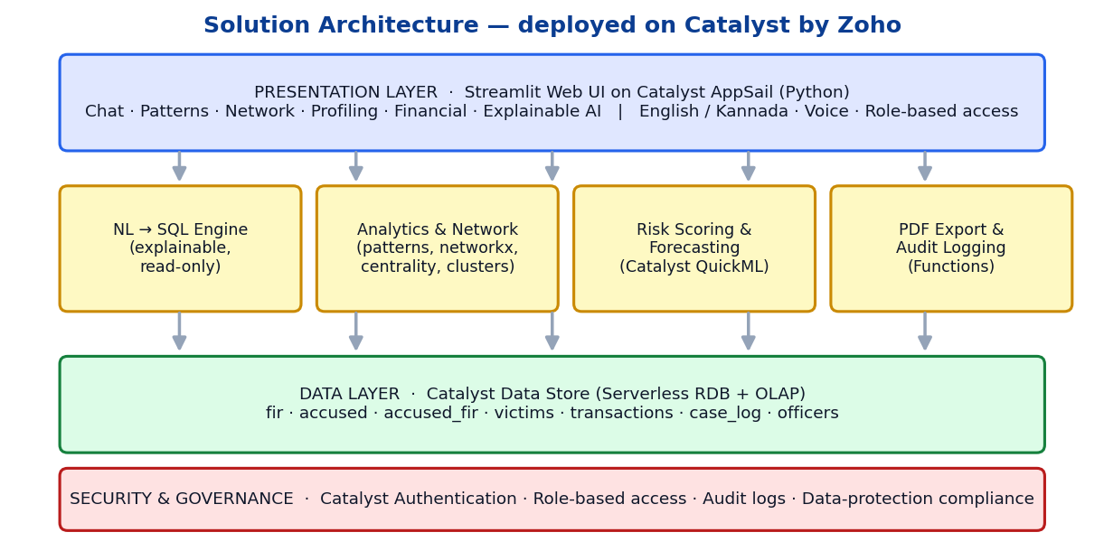
Architecture diagram of the proposed solution

Slide 8
Technologies to be used in the solution
Frontend / App
• Python · Streamlit (interactive web UI) · matplotlib charts
AI / Analytics
• Explainable rule/slot NL→SQL engine · networkx (graph & centrality) · pandas · risk-scoring model · QuickML (forecasting)
Data
• SQLite (prototype) → Catalyst Data Store (serverless RDB + OLAP) · synthetic NCRB/KSP-structured dataset
Languages / Other
• English + Kannada (i18n) · Web Speech API (voice) · reportlab (PDF export) · Faker (data generation)

Slide 9
List down Catalyst Services being used in the solution
AppSail
• Serverless Python web hosting for the Streamlit app (the deployed link).
Data Store
• Serverless relational DB with built-in OLAP for crime records & analytical queries.
Catalyst Functions (FaaS)
• NL-query microservice and PDF-export function.
QuickML
• No-code ML pipelines for crime forecasting and offender risk-scoring.
Authentication & Stratus
• Role-based access (investigator/analyst/supervisor/policymaker) + storage for exported PDFs.

Slide 10
Estimated implementation cost (optional)
Prototype runs on Catalyst's free developer tier — effectively zero cost.
• AppSail hosting (1 app, 512 MB): Free tier → ~₹0–1,500 / month at pilot scale
• Data Store (crime records): Free tier → pay-as-you-grow
• Catalyst Functions + QuickML: Free quota covers prototype workloads
• No third-party LLM API cost — NL→SQL engine runs fully offline.
Indicative production pilot (single district): well under ₹10,000 / month.

Slide 11
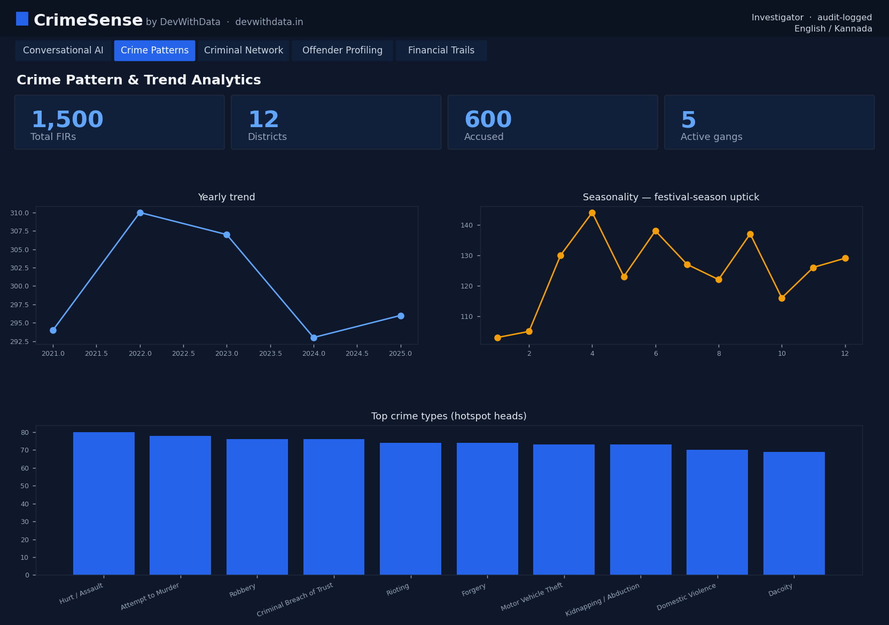
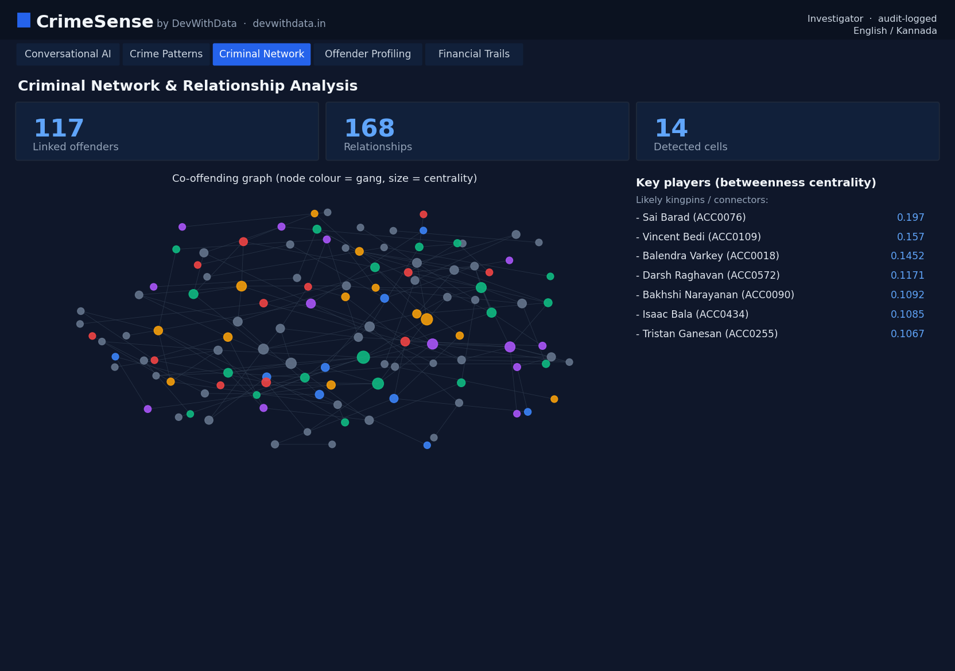
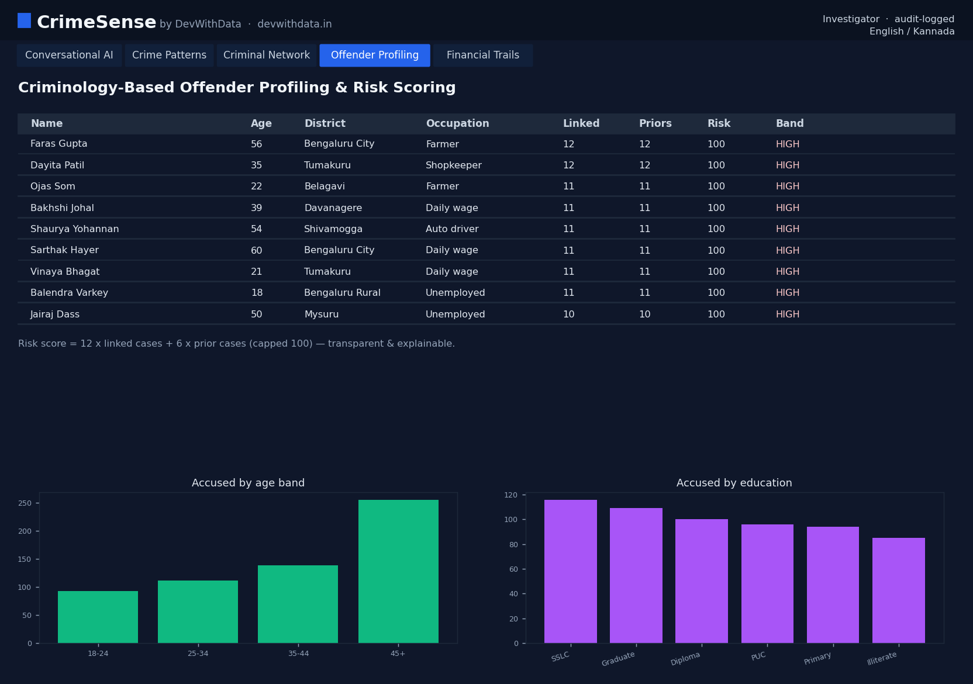
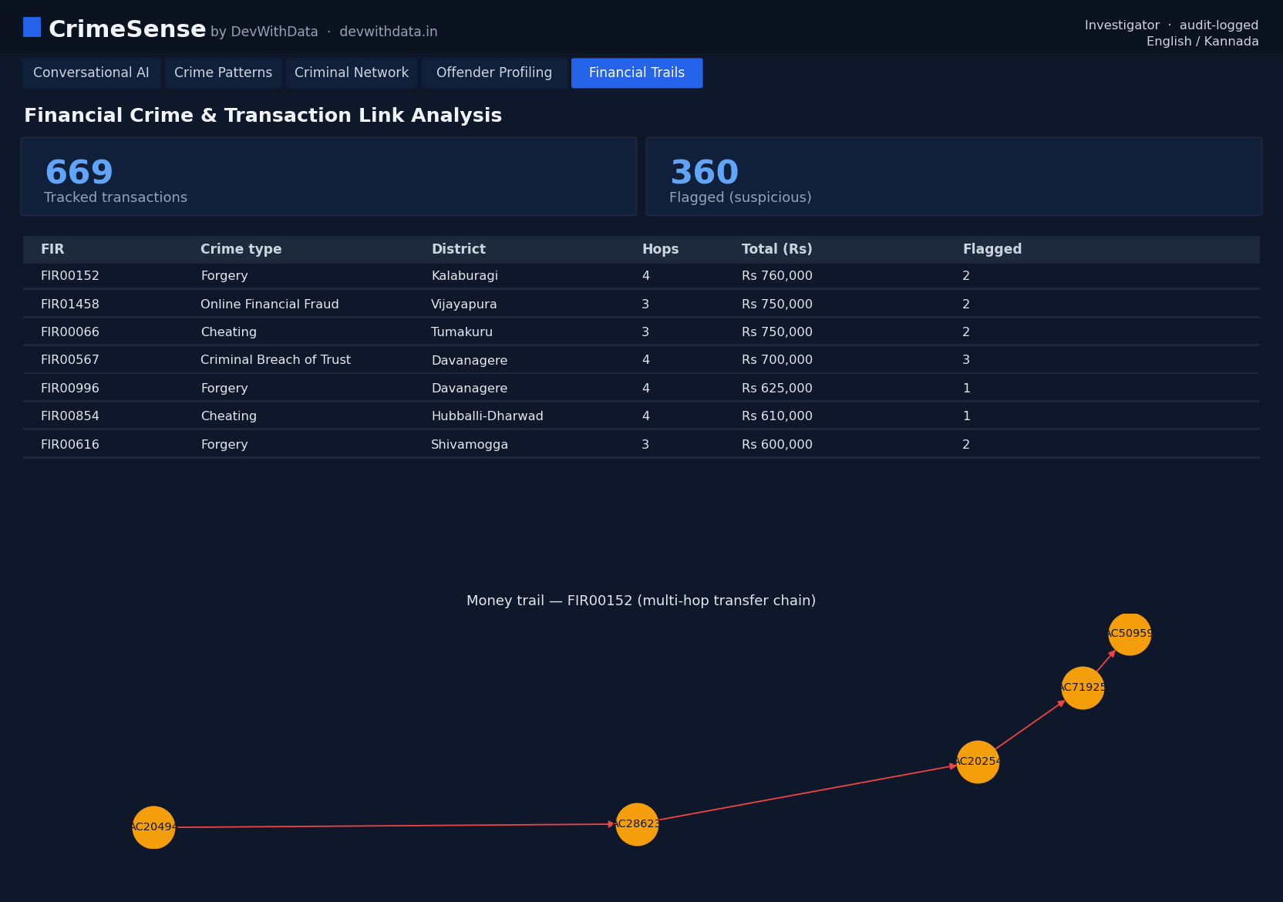
Snapshots of the prototype

Slide 12
Prototype Performance report/Benchmarking
Prototype benchmark (synthetic KSP-style dataset)
• Dataset: 1,500 FIRs · 600 accused · 1,571 victims · 669 financial transactions · 4,219 case-log events across 12 Karnataka districts.
• NL query response: < 200 ms (offline rule/slot engine + indexed SQLite).
• Intent coverage: count, trend, hotspots, breakdown, offenders, gangs, status, financial, case-detail — 9 intents, context-aware follow-ups.
• Network analysis: 117 linked offenders · 168 relationships · 14 organised-crime cells detected via modularity.
• Explainability: 100% of answers return SQL + reasoning trail. Read-only — zero write/DDL executed.

Slide 13
Provide links to your:
GitHub Public Repository
Demo Video Link (3 Minutes)
Deployed Link
GitHub Public Repository
https://github.com/<your-username>/Datathon-2026-KSP-CrimeSense ← replace with your public repo URL
Demo Video Link (3 minutes)
https://youtu.be/<unlisted-id> or public Google Drive link ← add after recording
Deployed Link (on Catalyst by Zoho)
https://crimesense-<id>.catalystserverless.com ← add after `catalyst deploy`
Note: all three links must be public & working before final submission (test in incognito).

Slide 14
Additional Details/Future Development (if any)
• LLM-augmented NL engine (Catalyst AI / Zia) for open-ended questions, while keeping the explainable offline path as fallback.
• Live integration with KSP CCTNS / FIR systems and real (access-controlled) data, with full audit & data-protection compliance.
• Geospatial hotspot maps and QuickML forecasting for early-warning alerts on repeat/gang crime.
• Full Kannada voice assistant (STT + TTS) for field officers.
• Bias & fairness auditing of risk scores, with human-in-the-loop review workflows.

Slide 15
Blank slide

Slide 16


